Slide 1
JoPACC
Gaps identified and recommendations
The reports show what happened. Readers also need to know why.
Q3 2024 to Q2 2026 quarterly reports
DERIVED = calculated from reports
Unmarked figures come from the JoPACC reports.
Notes:
Open with the one-line promise: the reports are accurate and consistent, but they tell us what happened, not why. Point to the marker key: derived figures were calculated from the published reports.

Slide 2
The reports describe what happened, not why
eFAWATEERcom
Researchers
Investors
-12.0%
No validation
Growth unclear
total value, Q1 2026
trends cannot be checked
sustainability cannot be judged
REPORT
REPORT
REPORT
Value fell. No driver given.
The what, in limited detail.
A reliable record of each quarter.
MISSED
MISSED
MISSED
Biller category or seasonal effect?
Drivers of users, volumes, values.
Whether growth will last.
Why it matters: readers must rely on assumptions, which risks misleading conclusions.
Notes:
The most significant gap is limited analytical depth. Example: eFAWATEERcom's total transaction value fell 12.0% in Q1 2026, and the report gives no sign of what drove it, such as a biller category or a seasonal effect. Researchers cannot validate trends; investors cannot judge whether growth is sustainable. The reports themselves are consistent and well structured.

Slide 3
Four recommendations to close the gap
1
Interactive UI
2
Average transaction value
Static tables > Drill-down by level
Totals only > A standard metric
3
Colorblindness Filter
Fixed palette > Adjustable color slider
Only existing data: every recommendation uses figures already in JoPACC's dataset.
Notes:
The plan on one slide: each tile shows how reporting works today and how it should work. All of it uses only data already available in JoPACC's dataset. Recommendation 1 comes first because the others build on it.

Slide 4
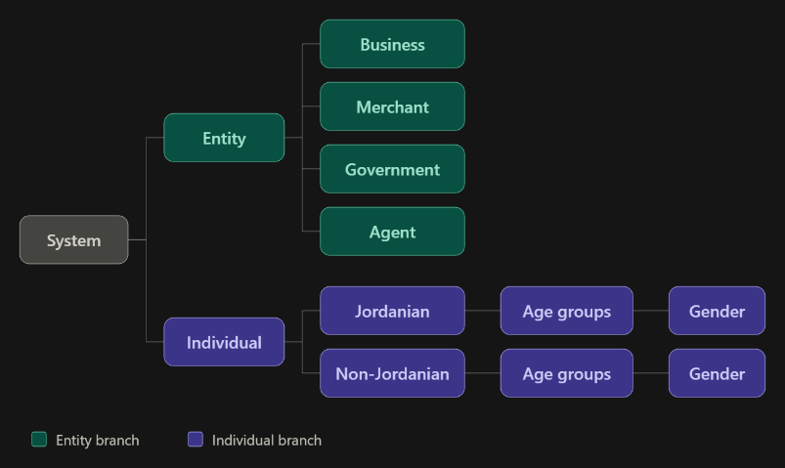
One shared hierarchy to organise IPS reporting
1
Entities and individuals
Entities: business, merchant, government, agent
2
Individuals by nationality
Jordanian and non-Jordanian
3
Age group, then gender
The most detailed level of the breakdown
Applied to the IPS: CliQ and JoMoPay figures combined under one shared structure.
Notes:
To apply the hierarchy to the IPS, the IPS section would be restructured around it. Figures from CliQ and JoMoPay are combined under one shared structure: entities (business, merchant, government, agent) and individuals first, then individuals by nationality, age group and gender.

Slide 5
Every level reports the same three measures
Users
Transactions
Value
number of users
number of transactions
transaction value (JOD)
Drill down
Protect confidentiality
Readers move from the system total to the most detailed breakdown, at the level they need.
Categories with very small counts are grouped together.
Why it matters: one structure, one set of measures, from system total to detail.
Notes:
For each level the report shows users, transactions and transaction value, using only published data. The same structure can power an interactive view so readers drill down from the system total to the most detailed breakdown. Categories with very small counts are grouped to protect confidentiality.

Slide 6
Why the interactive view comes first
Researchers
Build on it
1
Explore the data at the level of detail they need.
The other recommendations can work without an interactive interface.
Investors
2
Drill from the system total to the most detailed breakdown.
Interactivity extends what the reports offer.
Other readers
3
One report that serves a wider range of users.
Notes:
This recommendation is presented first because the others build upon it. The rest can be implemented without an interactive interface, but interactivity greatly extends what the reports can offer, so they can serve a wider range of readers.

Slide 7
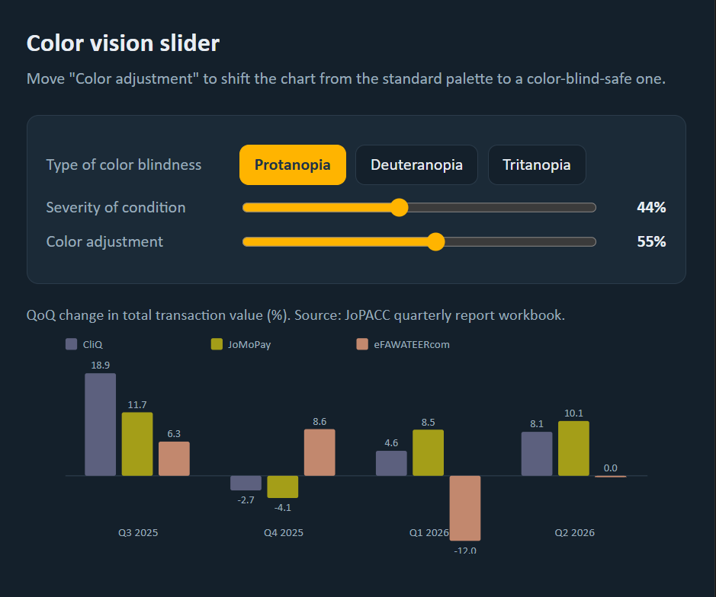
A slider instead of fixed color filters
1
Type and severity
Color vision deficiency varies in both
2
Gradual adjustment
Each reader tunes colors to what they see best
3
Setting is remembered
The reader’s choice applies across the portal
Why it matters: a reader who cannot tell the series apart cannot interpret the data correctly.
Notes:
Instead of one fixed filter per type of color blindness, the feature is a slider that adjusts the colors gradually. Color vision deficiency varies in both type and severity, so each reader can tune the palette to what they can distinguish best. The chosen setting could be saved so it applies across the portal.

Slide 8
Charts should not rely on color alone
Patterns
Direct labels
Markers
texture as well as color
labels placed on the chart
a distinct shape for each series
Readable without the slider
Follows accessibility guidance
Charts stay readable even when the feature is not in use.
WCAG advises against using color as the only way to convey information.
Where it matters most: charts that separate systems or show increases and decreases.
Notes:
As a complement to the slider, charts should not rely on color alone. Patterns, direct labels or distinct markers keep them readable even without the feature, in line with WCAG, which advises against using color as the only way to convey information. This matters most for charts that separate systems or show increases and decreases.

Slide 9
Key takeaway
Explain the growth, not just record it.
Interactive view, average value, per-system detail, value distributions.
Open questions the data cannot answer
What drove eFAWATEERcom’s increase in transaction value in Q3 2025?
Is growth from smaller payments sustainable?
What does the typical transaction look like?
Notes:
End on the three open questions to invite discussion.

